Slide 1
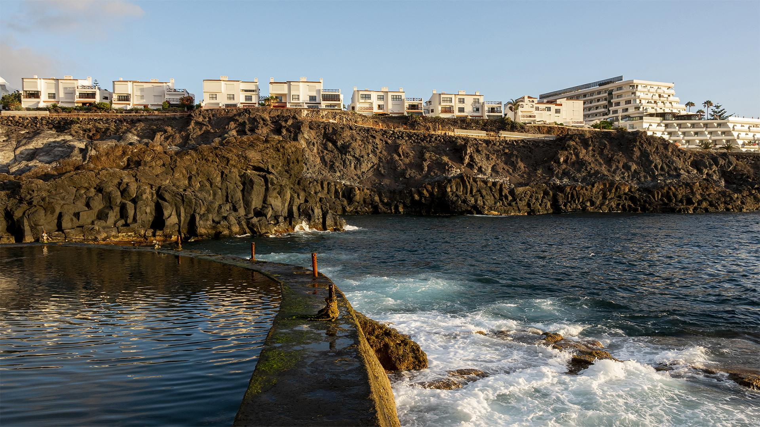
HOTEL CHAIN
Hotel Reservation Data Analysis
SINCE 2015

Slide 2
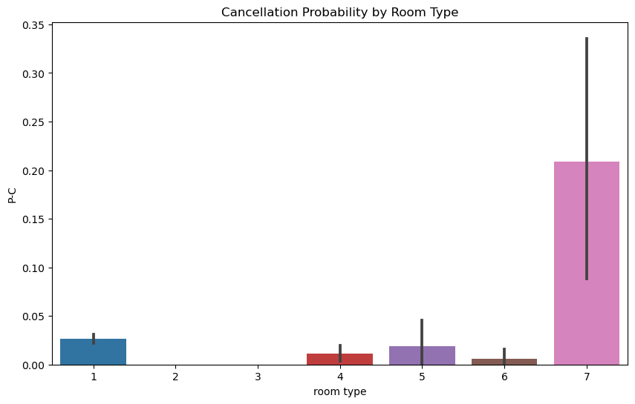
HOTEL CHAIN
Room Type – Probability of Cancellation
The attached graph shows that room 7 is the room with the most cancellations. This may be due to the lack of services in that room, or the high price of the room compared to the comfort provided, or the proximity of the room to various services, which causes inconvenience to residents. While room 3 appears to be the room with the least cancellations, as the price of booking this room is the lowest among the other hotel rooms, which may be a major reason for this.

Slide 3
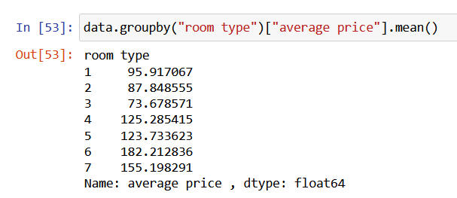
Average price – Room type

Slide 4
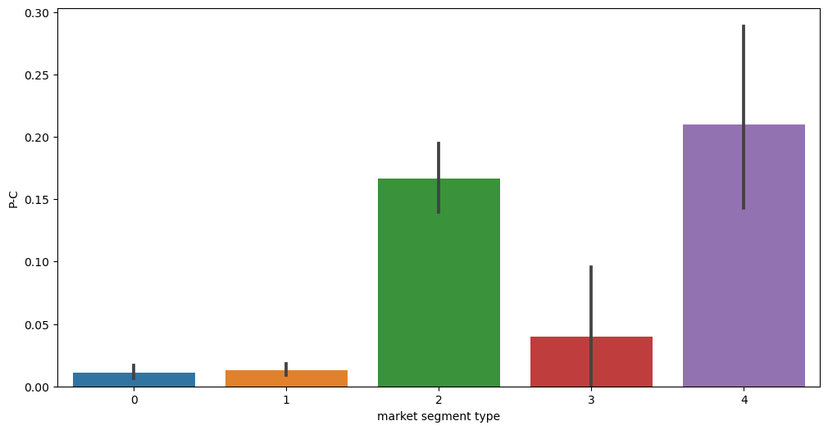
Market segment type – Probability of Cancellation
0- Offline
1- Online
2- Corporate
3- Aviation
4- Complementary
The marketing segment significantly impacts cancellation rates, especially among corporate or complementary bookings. These segments show a higher likelihood of cancellations compared to other types. This trend suggests that factors unique to corporate arrangements or complementary stays may influence guests' decisions to cancel their reservations more frequently.

Slide 5
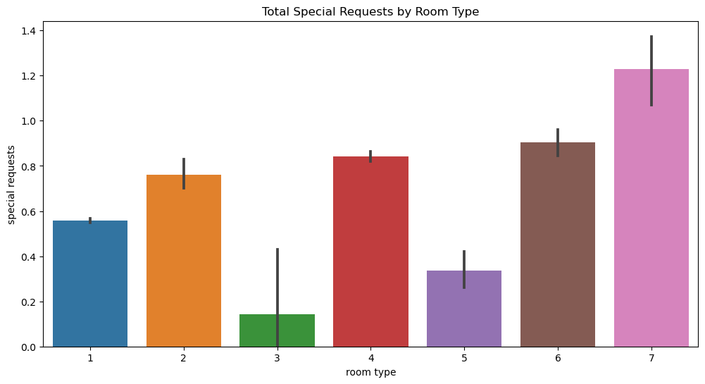
Room type - Special requests
Room 7 is priced higher than the other rooms, indicating that most guests who book it have a higher income and can afford premium quality accommodations. These guests often seek a more luxurious experience and tend to make more special requests, reflecting their expectations for top-notch services and amenities. In contrast, Room 3 is priced at an average rate, attracting guests with a more modest budget. These guests typically do not go for the same level of luxury or special requests, aligning with a middle-income social level that prioritizes value and practicality over luxury.

Slide 6
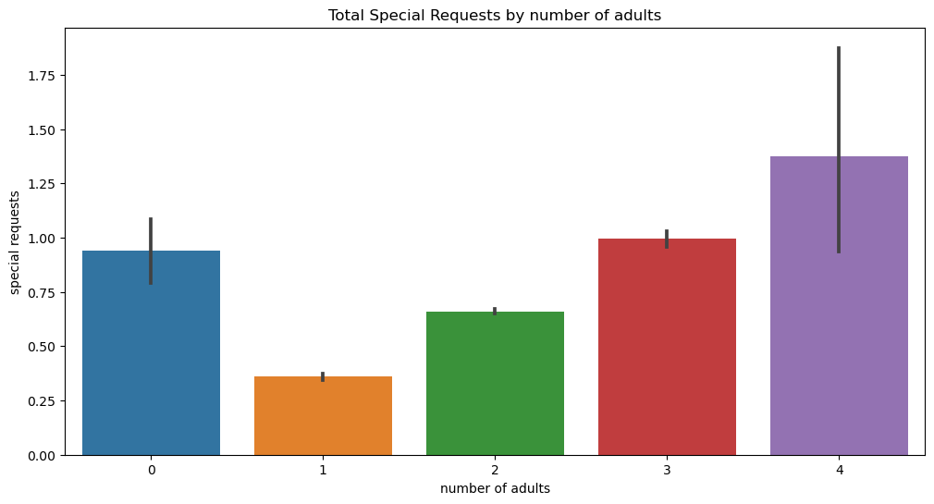
Number of adults – Special requests
The number of adult guests appears to influence the frequency of special orders. When the number of adults increases, there is typically a corresponding rise in special orders. This trend suggests that larger groups of adults often require more personalized services or accommodations during their stay.

Slide 7
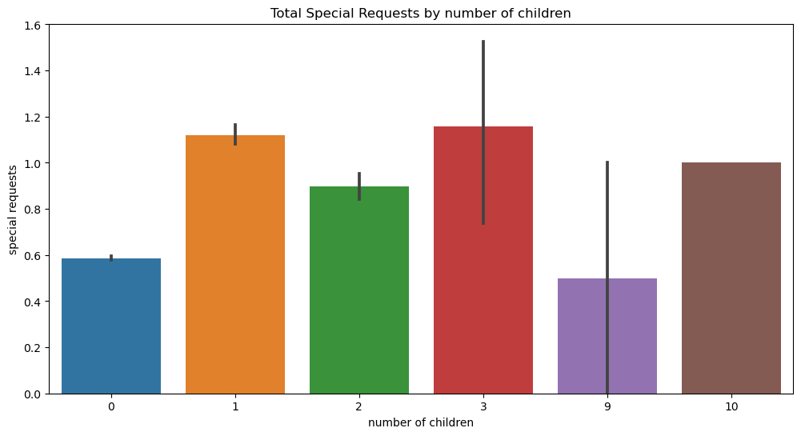
Number of children - Special requests
For children, when there are between one to three children staying, special orders remain relatively high. Children don’t think about money or saving it, so even one child can make a lot of special requests. This indicates that families with children frequently need additional services or special accommodations to ensure a comfortable and enjoyable stay.

Slide 8
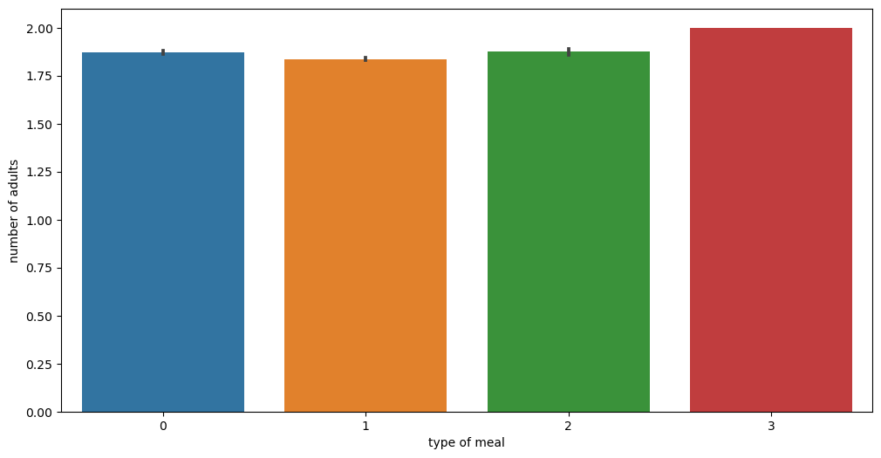
Type of meal – number of adults
When adults order meals, they tend to choose a variety of options, including all the meals offered. However, the lowest-priced meal remains the most frequently ordered among them, possibly indicating a preference for saving money.

Slide 9
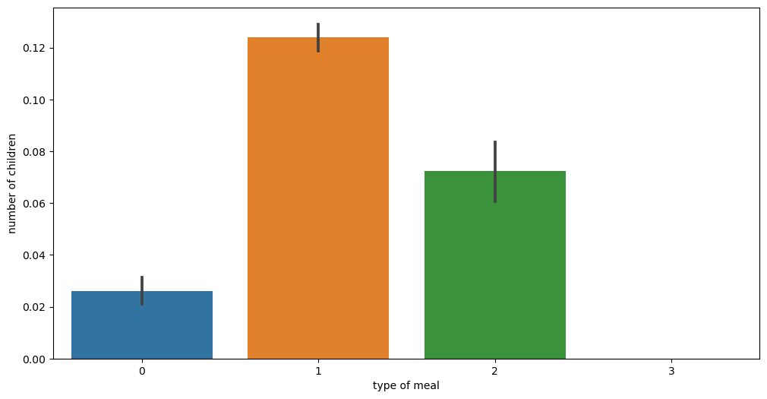
Type of meal - Number of children
children, they typically do not choose the lowest-priced meal; instead, they often go for higher-priced food items. This behavior may be influenced by their perspective as children, where saving money is not their main consideration.

Slide 10
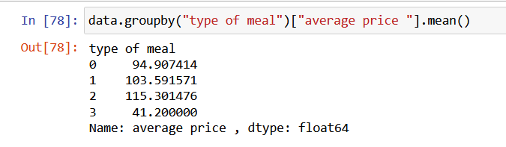
Average price - Type of meal

Slide 11
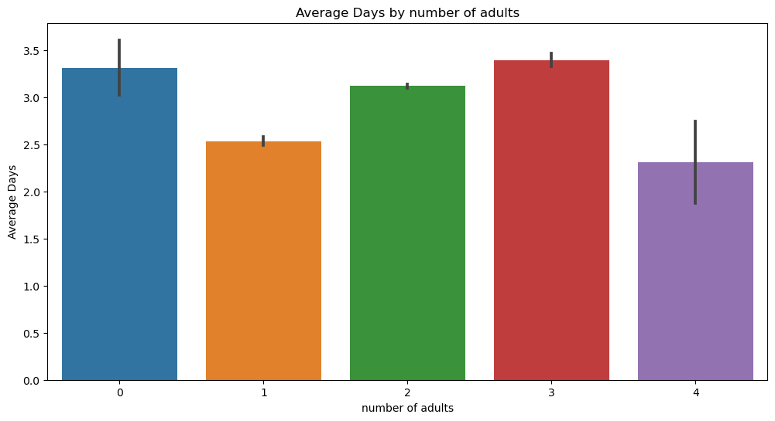
Number of adults – Average days
From the bar plot of the number of adults and average days, the key insights are:
Solo travelers (1 adult): These bookings have the shortest average stay of around 2.5 days, likely due to the nature of quick business trips or short getaways.
Groups of 2 adults: These bookings have a moderate average stay of about 3 days, common for couples or friends traveling together.
Groups of 3 adults: These bookings have a slightly higher average stay, suggesting that larger groups might stay longer due to shared expenses and more planned activities.
Groups of 4 adults: These bookings also have a moderate average stay, similar to groups of 2 adults, indicating a trend towards shorter, practical stays.

Slide 12
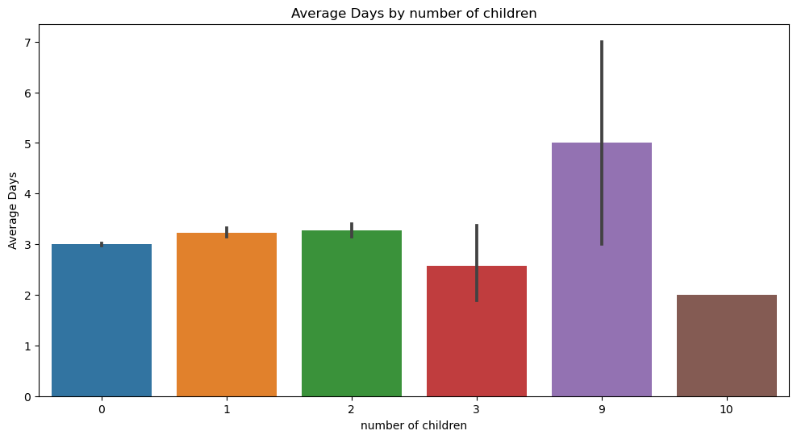
Number of Children – Average days
From the bar plot of the number of children and average days, the key insights are:
One Child (1 child): Families with one child show a slightly longer average stay of around 3.5 days. This might indicate that small families are likely to stay a bit longer, possibly for short vacations or weekend getaways.
Two or More Children (2+ children): The trend for families with two or more children shows a further increase in the average stay duration. These families might be planning more extended vacations, making the most of their travel to accommodate the needs and activities for their children.

Slide 13
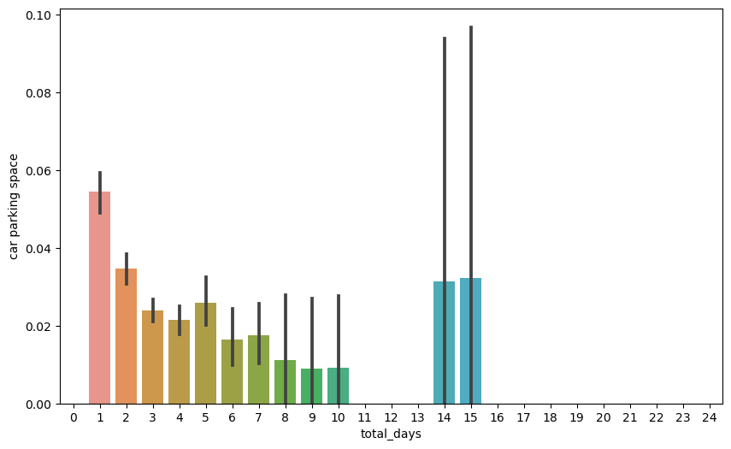
Total days - Car parking space
Peak at 1 Day: The car parking space usage is highest when the total days are 1, suggesting that the parking space is most frequently used for shorter durations.
Decreasing Trend: There is a general decreasing trend in car parking space usage as the total days increase up to about 10 days
Outliers at Higher Days: There are noticeable peaks at 14 and 15 days, indicating unusual usage patterns or potential outliers.
Benefits:
Resource Allocation: This information can help in better managing and allocating parking resources. For example, knowing that short-term parking is more common, more resources can be allocated for short-term parking spaces.
Pricing Strategy: This data can inform pricing strategies. If short-term parking is more popular, dynamic pricing can be applied to maximize revenue while managing demand.

Slide 14
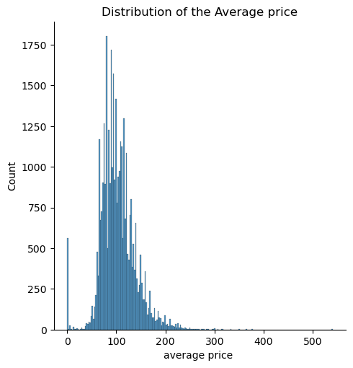
Average-price Distribution
Right-Skewed Distribution: The distribution of the average price is highly right-skewed, indicating that most of the prices are concentrated on the lower end of the scale with a long tail extending to the higher prices.
Benefits:
Understanding Pricing Trends: This visualization helps in understanding the pricing trends and the range within which most of the prices fall. This can be beneficial for businesses to set competitive prices.
Identifying Outliers: The presence of outliers can indicate anomalies or special cases that might require further investigation.
Target Marketing: Marketing efforts can be more effectively targeted knowing the most common price points. Promotions and discounts can be strategized around the most common price ranges to maximize customer engagement.

Slide 15
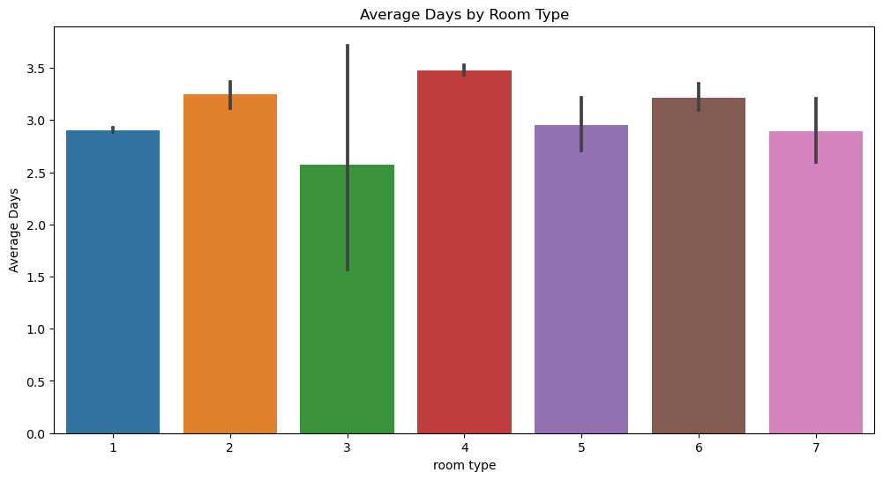
Room type – Average days
For the room type and average days of stay, Room 3 tends to have the lowest price. This could be because guests booking Room 3 are often looking for a short, budget-friendly vacation of 2 or 3 days, minimizing their expenses. Room 3 might offer lesser quality or features, prompting guests to prefer shorter stays rather than longer ones.

Slide 16
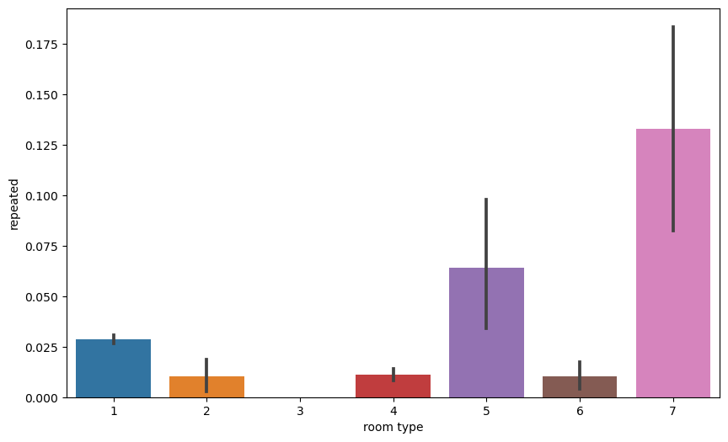
Room type - Repeated
From the bar plot of the Room type and Repeated, the key insights are:
Room Type 7: This room type shows the highest probability of repeat bookings. This can be attributed to either its high quality or its many features that keep guests coming back frequently.
Room Type 1,5: These rooms type also shows a relatively high probability of repeat bookings. This suggests that while Room 5 or 1 is frequently chosen for repeat stays, it may be because it is very affordable for its features.
Room Types 2, 3, 4, and 6: These rooms types have the lowest probability of repeat bookings. Room 3, which is known for having the lowest cancellations and lowest booking price, is likely to attract value-seeking guests, which may result in fewer repeat bookings as these guests look for more economical options. Rooms 2, 4 and 6 also show lower repeat booking frequencies, indicating that guests may not find these room types compelling enough to visit again.

Slide 17
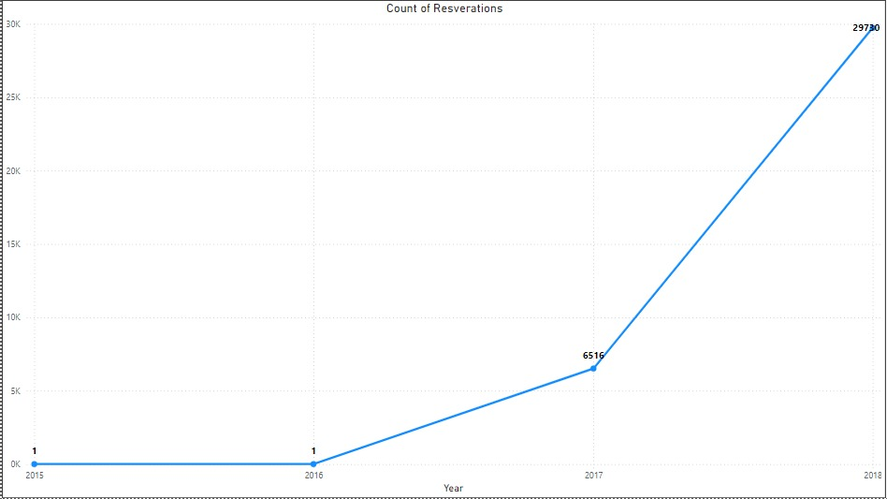
Number of resverations by Year

Slide 18
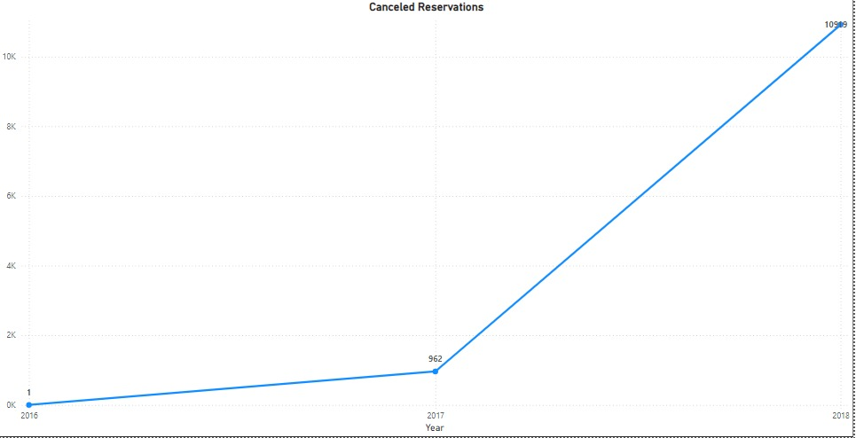
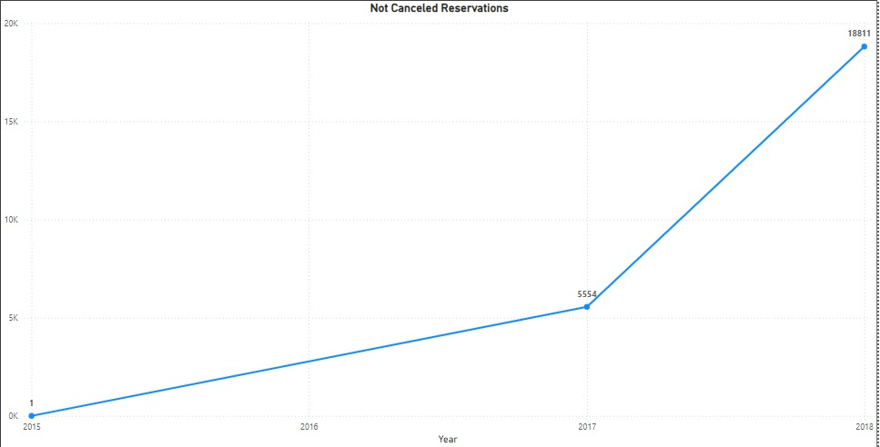
Canceled and not canceled by Year

Slide 19
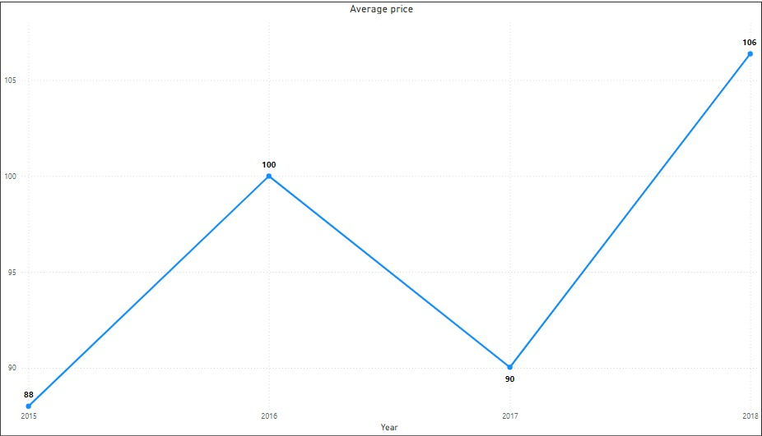
Average -price by Year

Slide 20
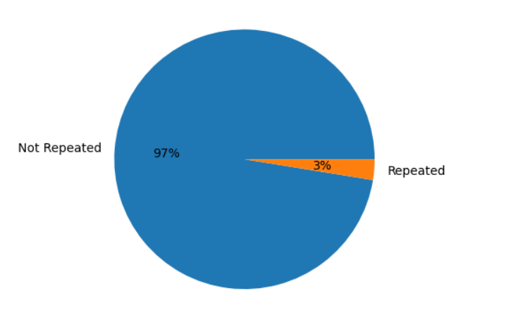
Repeated – Not repeated

